Slide 1

Job Creation in the U.S.
Yiwen Xu
Qinwen Yang

Slide 2
Background
Economic recession will affect every aspect of life. For job seekers and employees, the direct impact of the recession is the reduction of job positions, or even worse, layoffs from the company.
Two economic recessions:
2001 Q1 to 2001 Q3
2008 Q1 to 2009 Q2
The third recession being compared
2020 Q2 to 2020 Q3

Slide 3
Paper Introduction
Job Creation by Small and Large Firms over the Business Cycle (by Murat Tasci & Emily Burgen)
Publication time: February 6, 2012
Data source: Bureau of Labor Statistics
Job Openings and Labor Turnover Survey
Bar chart: payroll employment quarterly change
Line charts: net job creation, gross job gains, gross job losses, contribution to job gains relative to job losses
contributions to job openings

Slide 4

Paper Identification
Type One

Slide 5
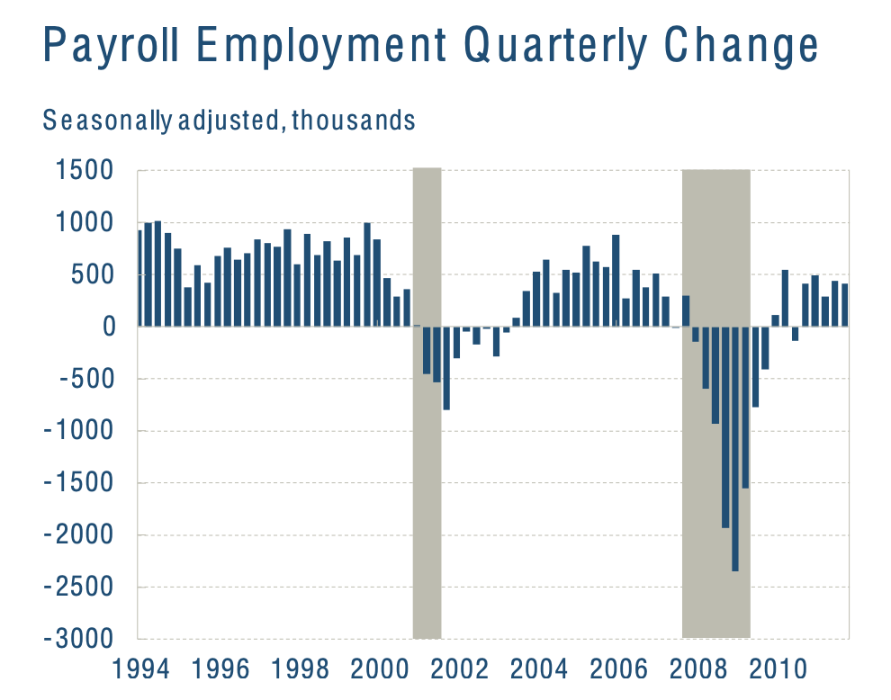
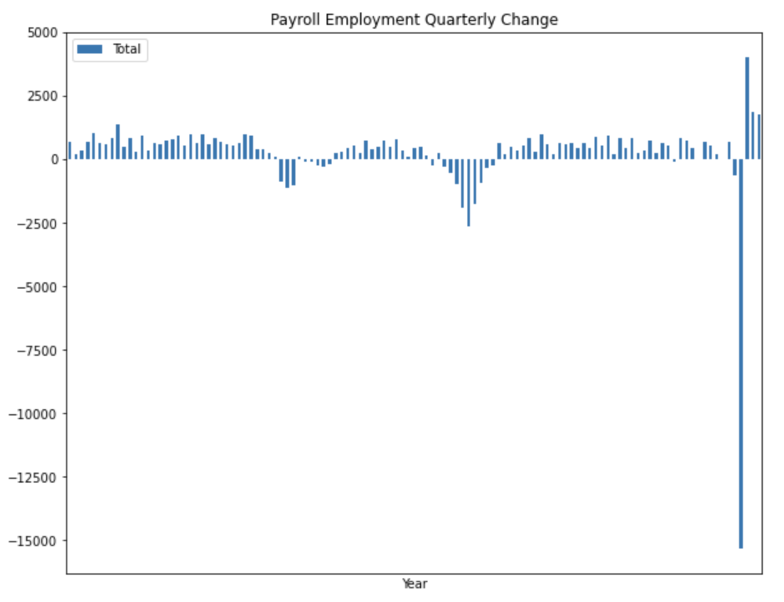
Paper Identification

Slide 6
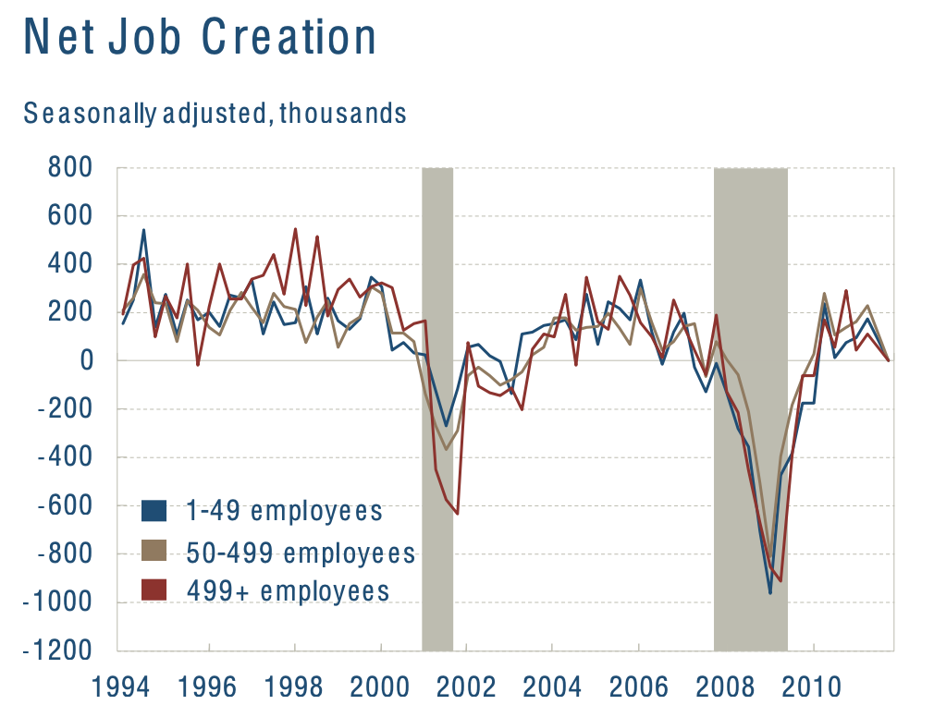
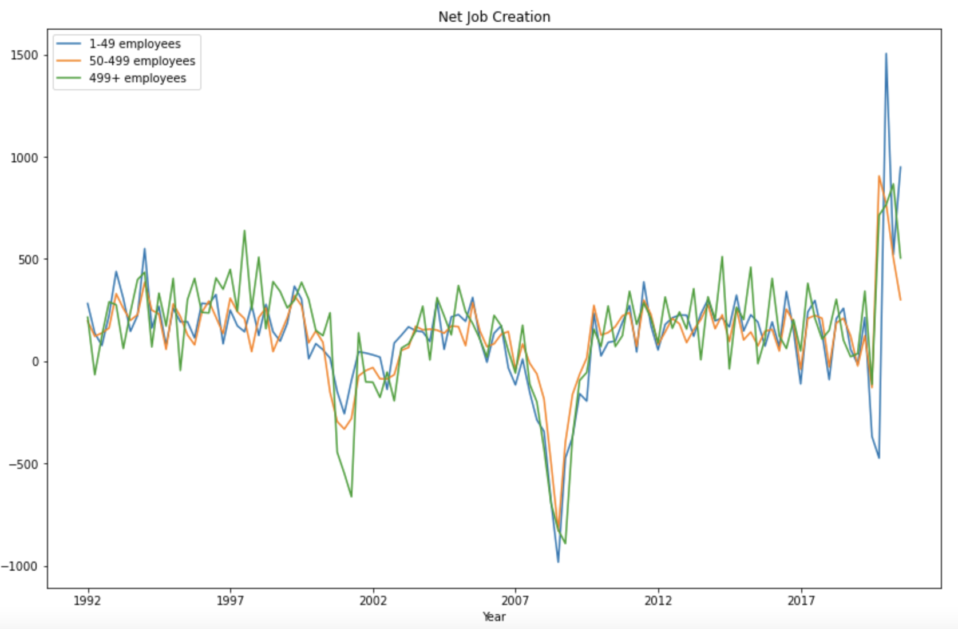
Paper Identification

Slide 7
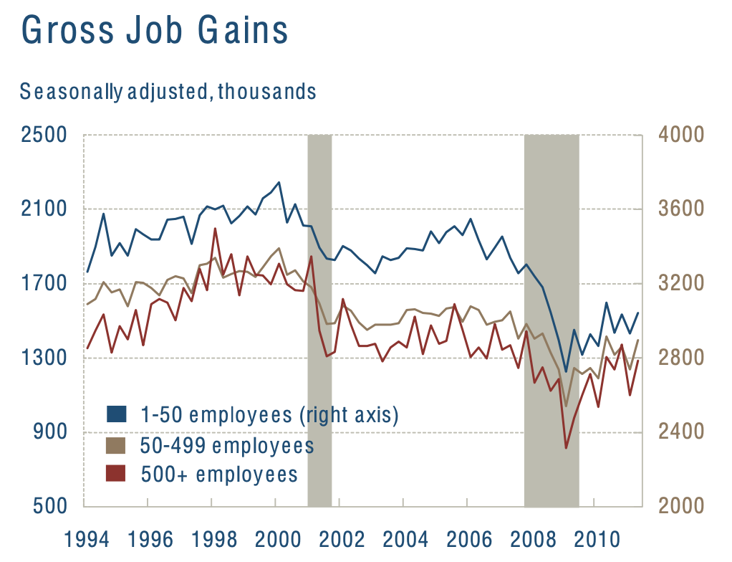
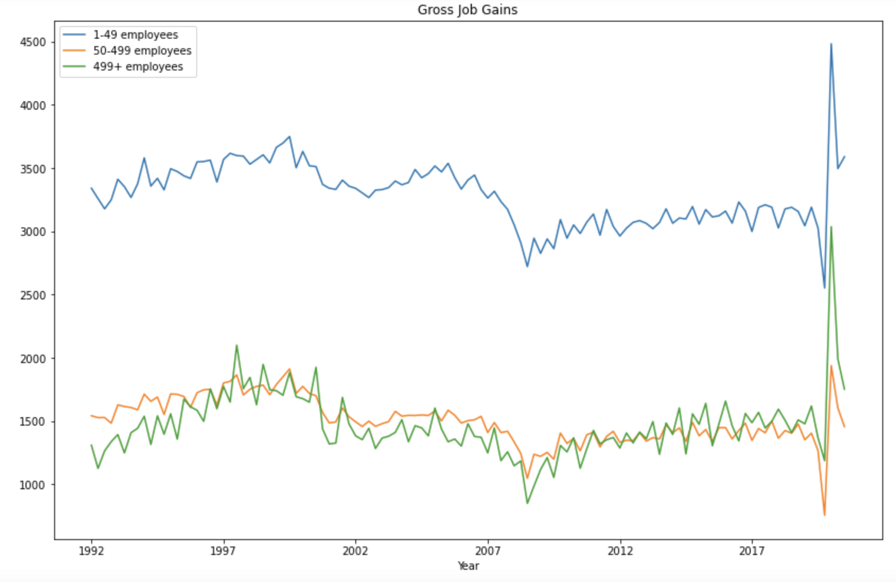
Paper Identification

Slide 8
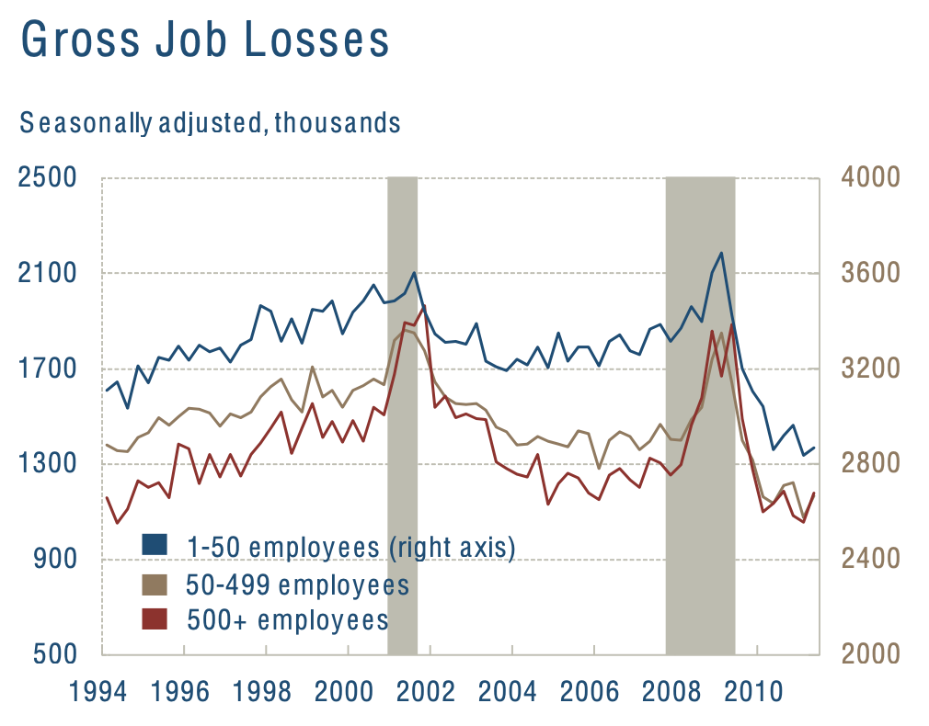
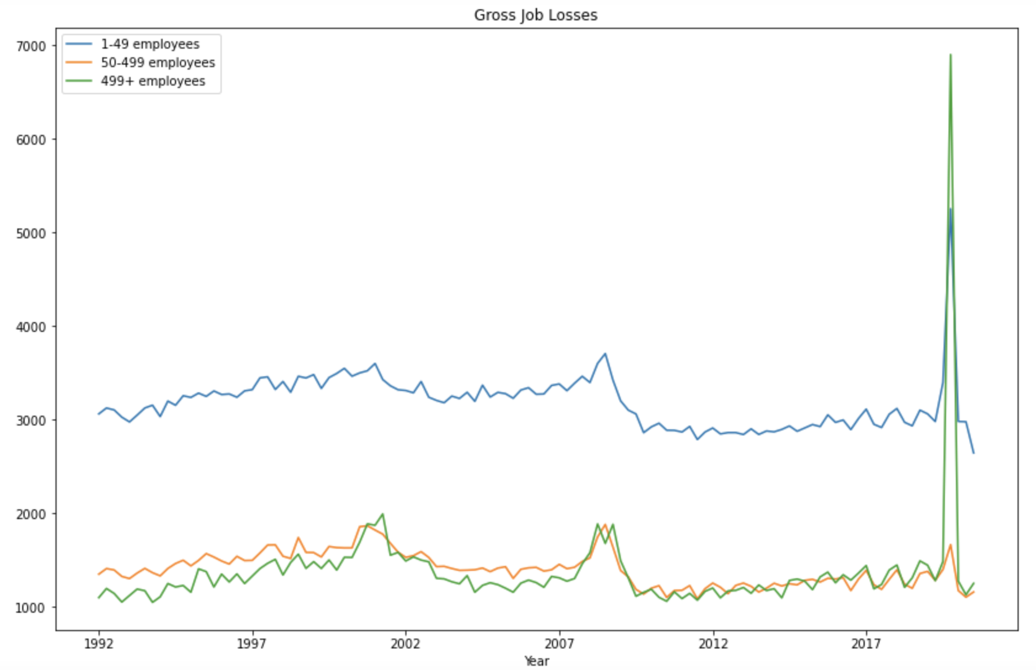
Paper Identification

Slide 9
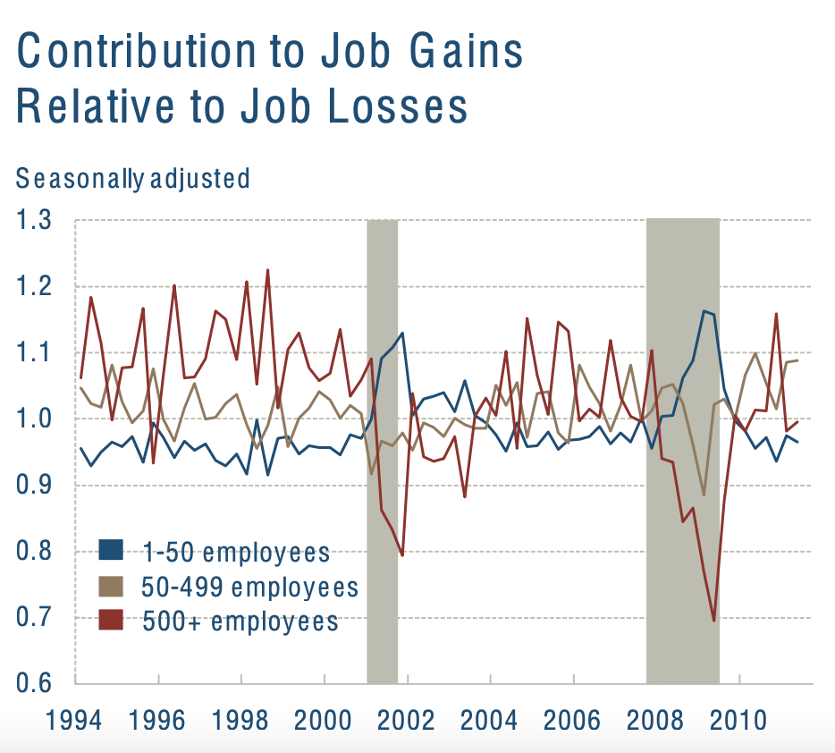
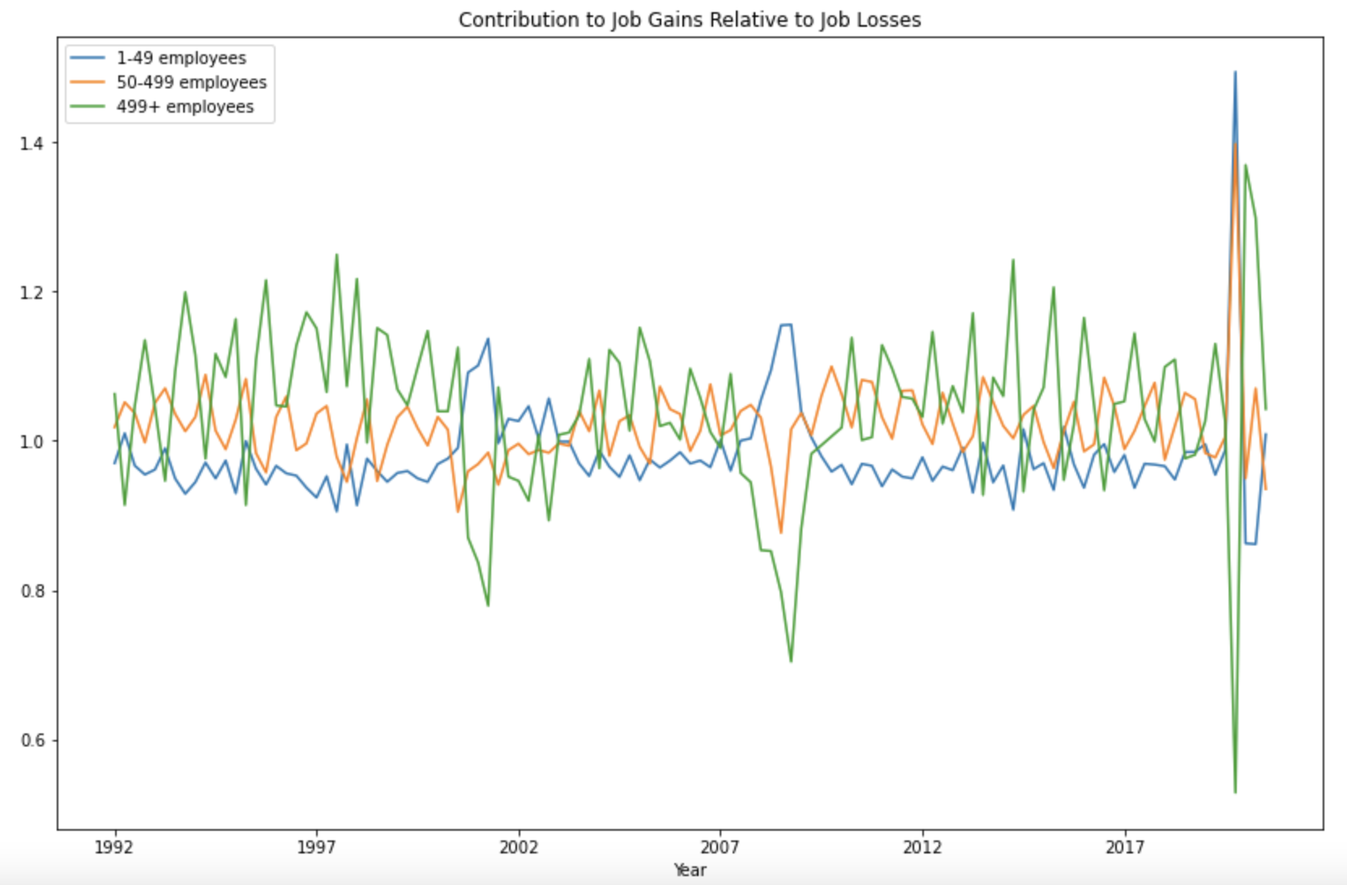
Paper Identification

Slide 10
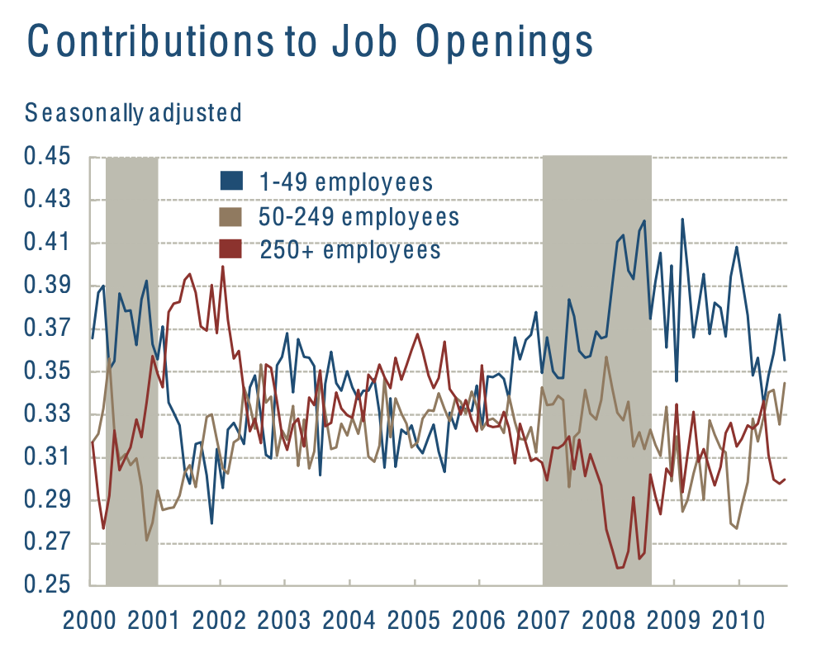
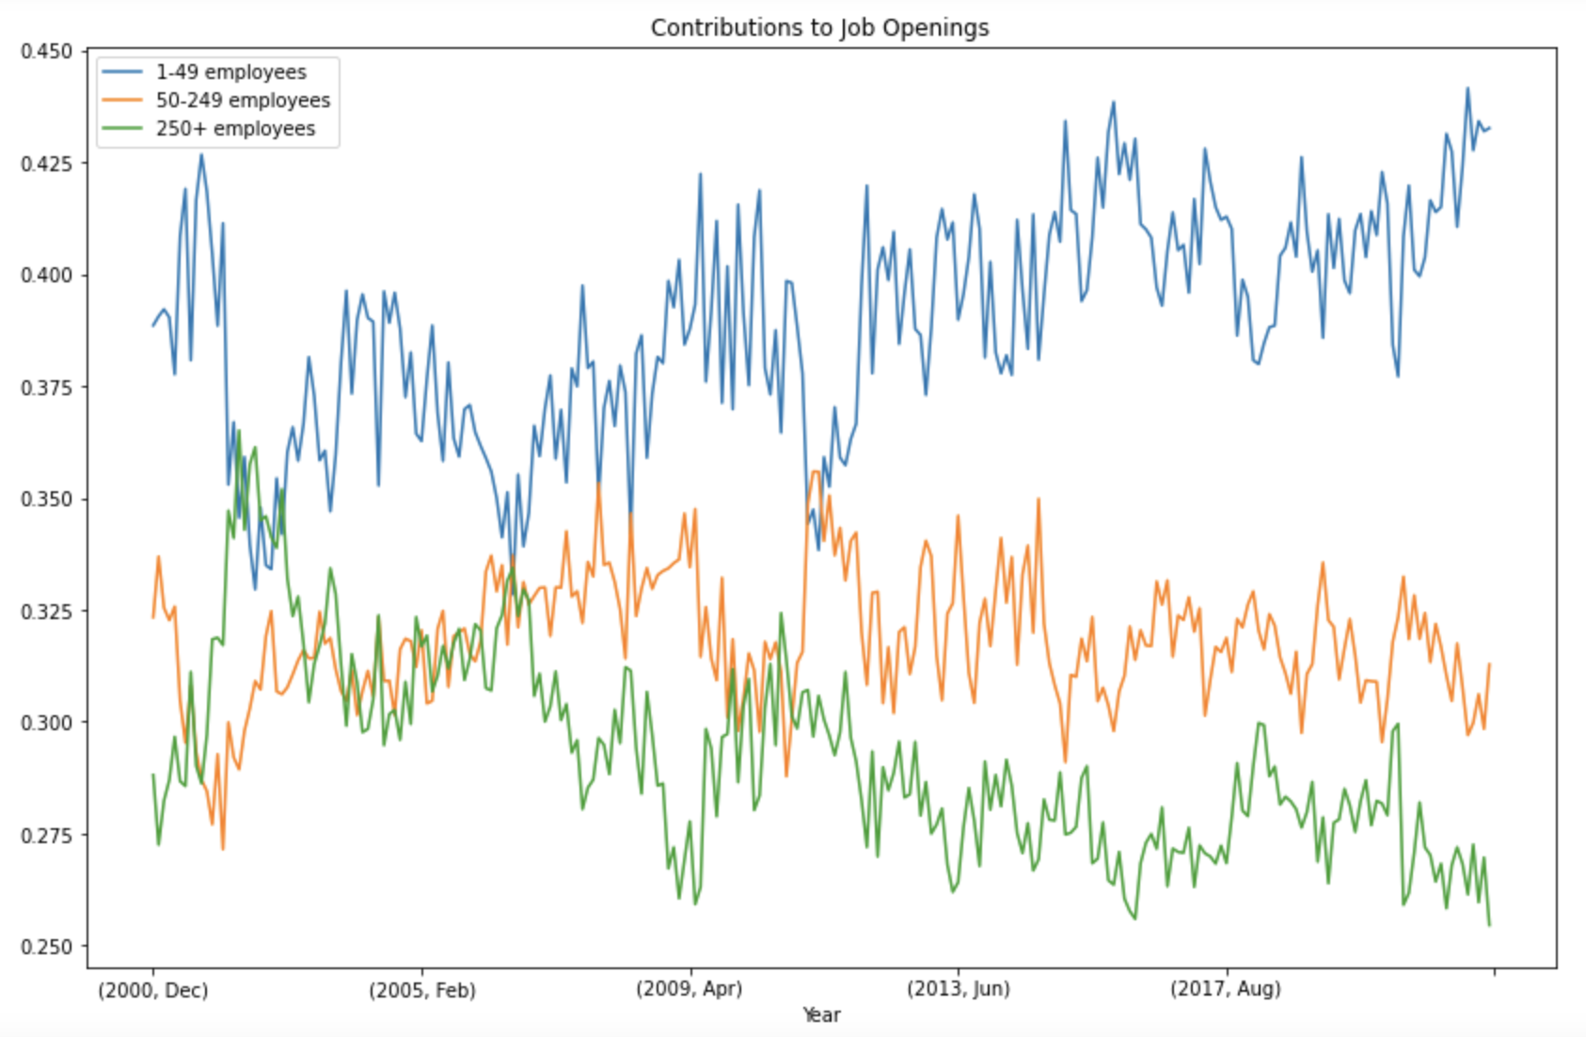
Paper Identification

Slide 11
Paper Identification
Why different?
Mistake of the paper
Data adjustment of the platform (Job Openings and Labor Turnover Survey)

Slide 12
Data Analysis Expansion
Type Three

Slide 13
Hypotheses
Hypothesis 1: the number of Covid-19 cases in the United States is negatively correlated with job gains in the beginning.
Datasets: Job Creation(sum) & COVID-19 Daily Cases in the U.S.
Hypothesis 2: small firms have worse resilience capabilities during the epidemic.
Datasets: Job Creation & COVID-19 Daily Cases in the U.S.
Hypothesis 3: the increase in the coverage of the Covid-19 vaccination does not bring more job opportunities.
Datasets: Job Creation & COVID-19 Daily Vaccinations in the U.S.

Slide 14
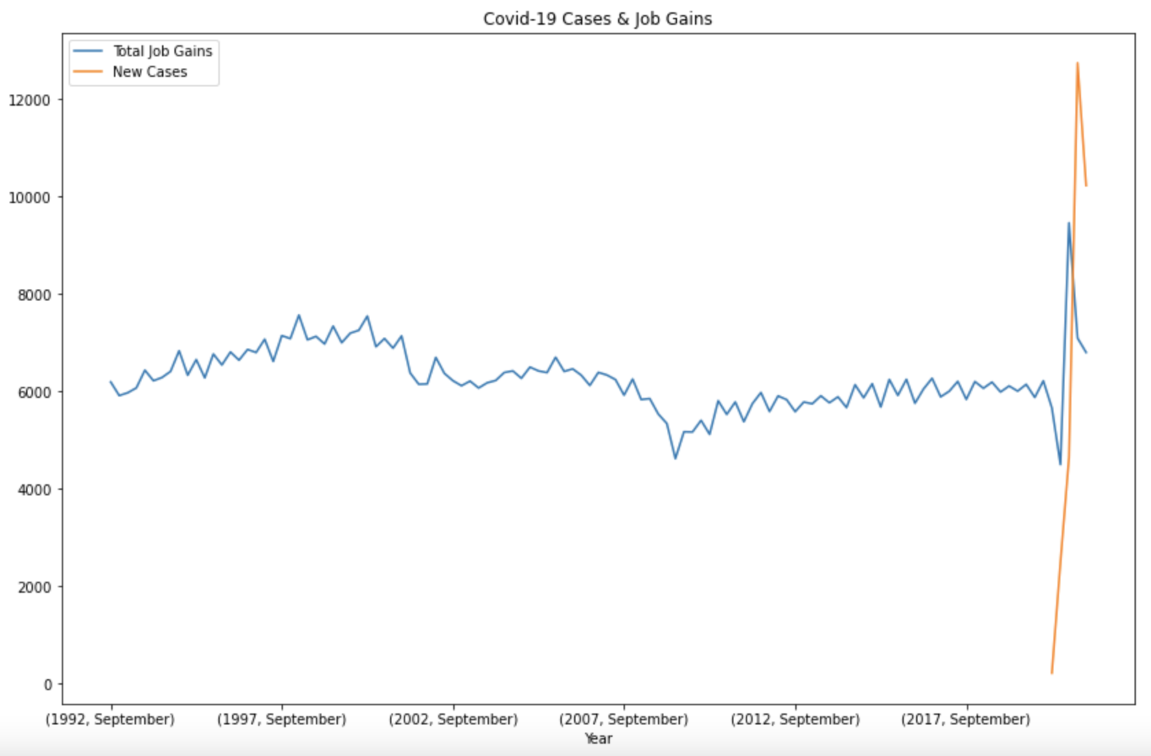
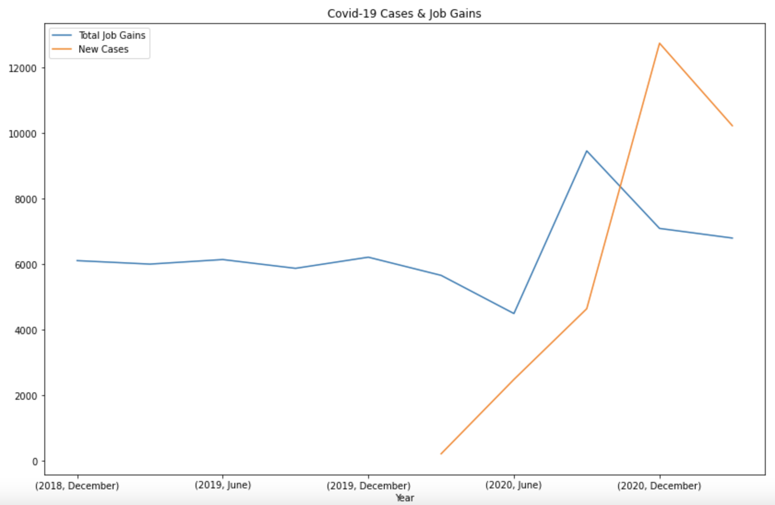
Hypothesis 1

Slide 15
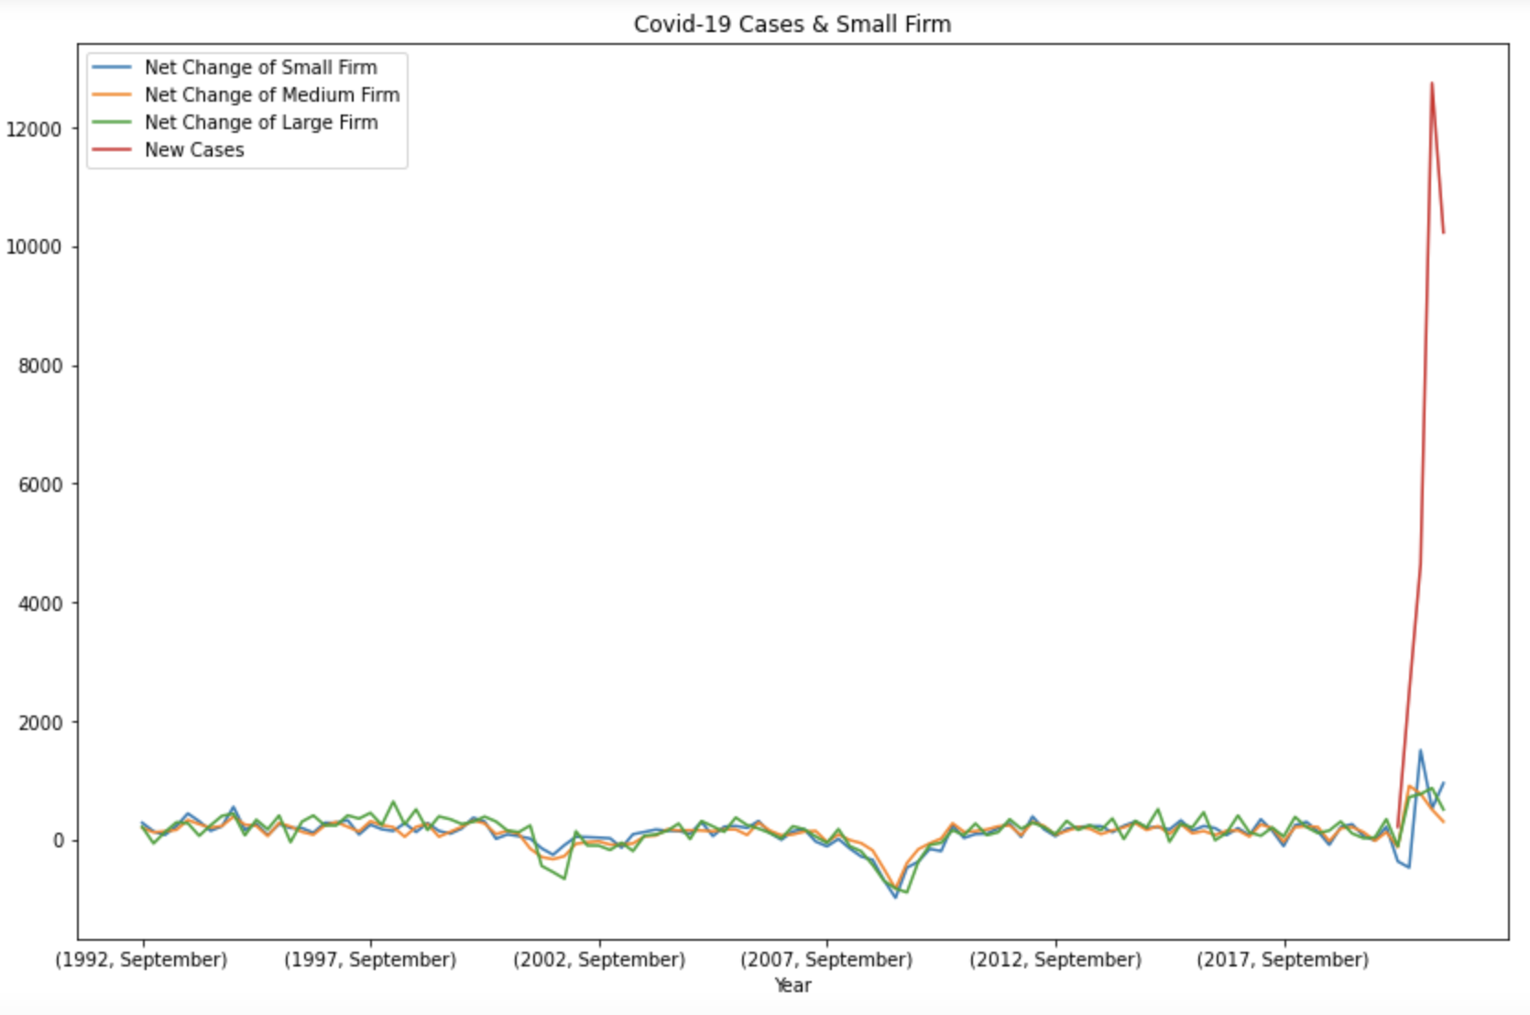
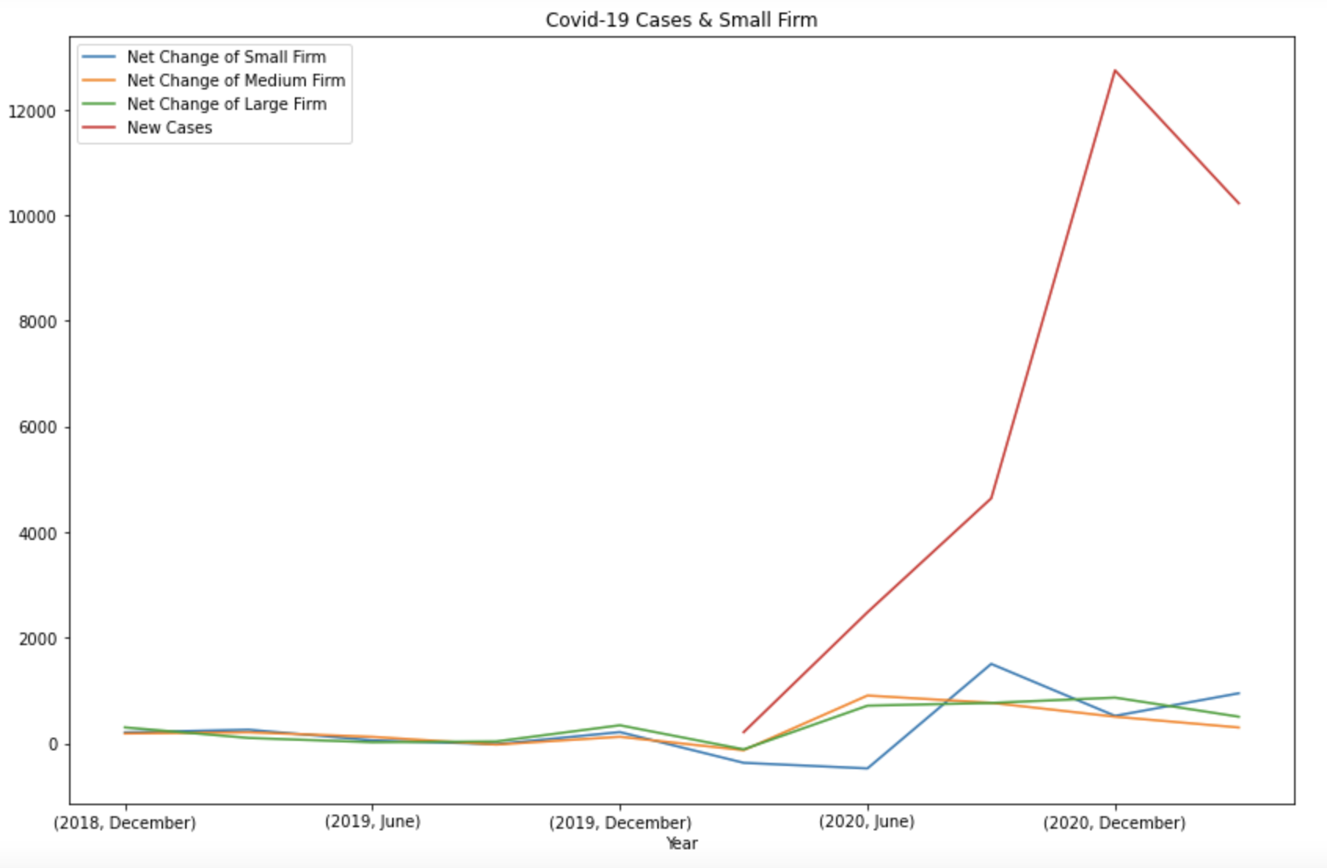
Hypothesis 2

Slide 16
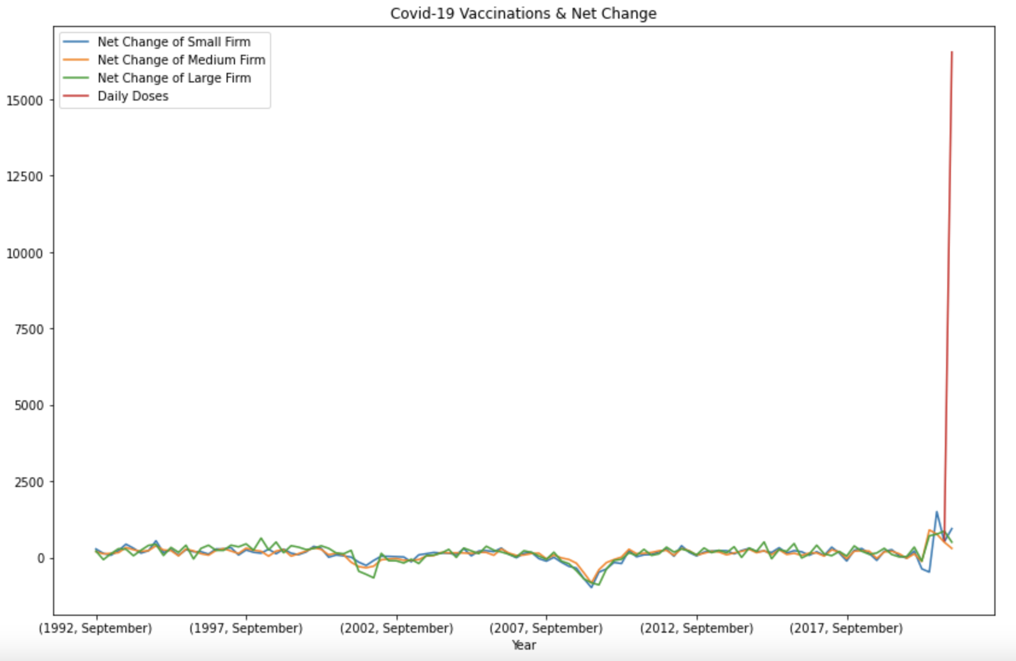
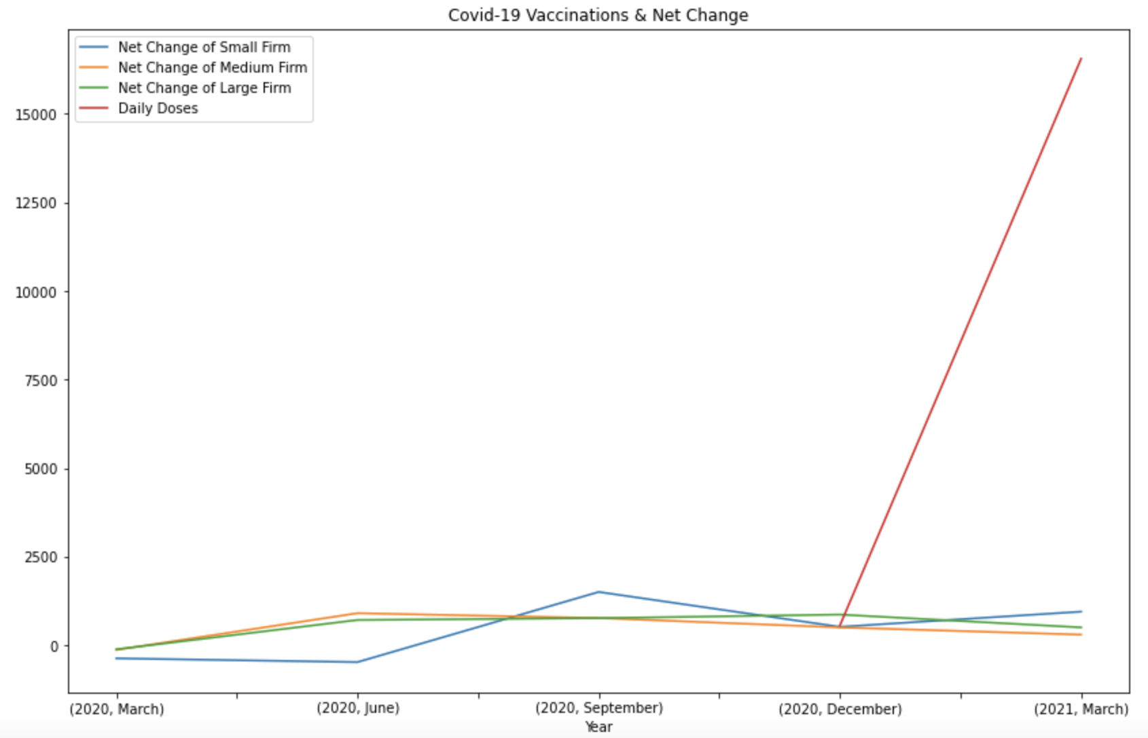
Hypothesis 3

Slide 17
Conclusions
Conclusion 1: total job gains in the United States is negatively correlated with Covid-19 cases in the beginning (March 2020 to June 2020), then begins to rebound.
Conclusion 2: small firms have worse resilience capabilities during the epidemic compared with medium and large ones.
Conclusion 3: it is hard to identify the relationship between the Covid-19 vaccination and job opportunities because of the low time coincidence of the two datasets.

Slide 18
Thank You
Yiwen Xu
Qinwen Yang

